Slide 1
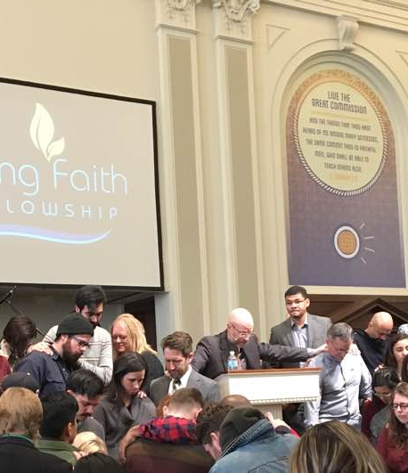
FOCUS SESSION #4
PLANTING CHURCHES: APPROACH TO
MINISTRY MULTIPLICATION.

Slide 2

A faith based view of the
Word of God.
Notes:
© Copyright Showeet.com – Free PowerPoint Templates

Slide 3
Psalm 119:89 For ever, O LORD,
thy word is settled in heaven.
Psalm 119:152 Concerning thy testimonies, I have known of old that thou hast founded them for ever.
Psalm 12:6-7 The words of the LORD are pure words: as silver tried in a furnace of earth, purified seven times. ⁷ Thou shalt keep them, O LORD, thou shalt preserve them from this generation for ever.
Notes:
© Copyright Showeet.com – Free PowerPoint Templates

Slide 4

A faith based view of the work of God.
Notes:
© Copyright Showeet.com – Free PowerPoint Templates

Slide 5
Hebrews 4:12 For the word of God is quick, and powerful, and sharper than any twoedged sword, piercing even to the dividing asunder of soul and spirit, and of the joints and marrow, and is a discerner of the thoughts and intents of the heart.
Hebrews 4:13 Neither is there any creature that is not manifest in his sight: but all things are naked and opened unto the eyes of him with whom we have to do.
Notes:
© Copyright Showeet.com – Free PowerPoint Templates

Slide 6

sending key men – with key tools – to key cities.
Sending trained
proven (fruitful) local church leaders.
A change in location WILL NOT produce a change in your potential later. Your geography doesn’t make you a better quality person.
Notes:
© Copyright Showeet.com – Free PowerPoint Templates

Slide 7
Luke 16:10 He that is faithful in that which is least is faithful also in much: and he that is unjust in the least is unjust also in much.
Notes:
© Copyright Showeet.com – Free PowerPoint Templates

Slide 8

Our motto: Every member a minister.
Proven leaders are grown in ministry within the context of the local church.
Notes:
© Copyright Showeet.com – Free PowerPoint Templates

Slide 9

Find and then operate within your God given GIFTING.
Notes:
© Copyright Showeet.com – Free PowerPoint Templates

Slide 10

sending key men – with key tools – to key cities.
1. Sending trained proven (fruitful) local church leaders.
2. with proven ministry tools with
a proven ministry philosophy.
Notes:
© Copyright Showeet.com – Free PowerPoint Templates

Slide 11


Slide 12
sending key men – with key tools – to key cities.
1. Sending trained proven (fruitful) local church leaders.
2. with proven ministry tools with
a proven ministry philosophy.
Notes:
© Copyright Showeet.com – Free PowerPoint Templates

Slide 13
Want to be a proven leader?
PERSEVERE.
Proverbs 18:1-2 Through desire a man, having separated himself, seeketh and intermeddleth with all wisdom. ² A fool hath no delight in understanding, but that his heart
may discover itself.
Notes:
© Copyright Showeet.com – Free PowerPoint Templates

Slide 14
Luke 14:27-30 And whosoever doth not bear his cross, and come after me, cannot be my disciple. ²⁸ For which of you, intending to build a tower, sitteth not down first, and counteth the cost, whether he have sufficient to finish it? ²⁹ Lest haply, after he hath laid the foundation, and is not able to finish it, all that behold it begin to mock him, ³⁰ Saying, This man began to build, and was not able to finish.
Notes:
© Copyright Showeet.com – Free PowerPoint Templates

Slide 15
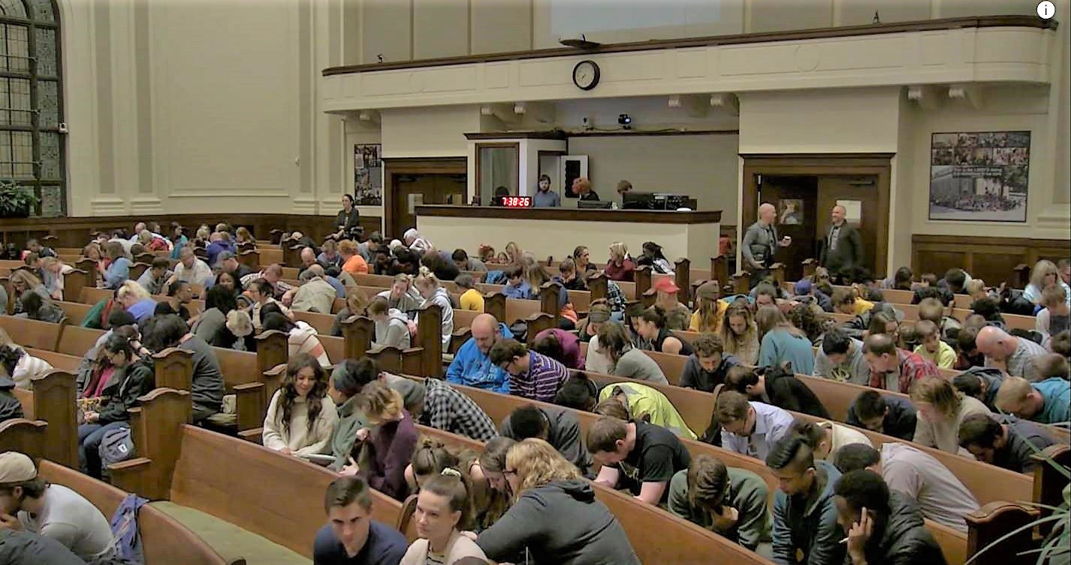
Large Image slide
Corporate prayer powers everything we do.
Notes:
© Copyright Showeet.com – Free PowerPoint Templates

Slide 16
Isaiah 55:6-11 Seek ye the LORD while he may be found, call ye upon him while he is near: ⁷ Let the wicked forsake his way, and the unrighteous man his thoughts: and let him return unto the LORD, and he will have mercy upon him; and to our God, for he will abundantly pardon. ⁸ For my thoughts are not your thoughts, neither are your ways my ways, saith the LORD. ⁹ For as the heavens are higher than the earth, so are my ways higher than your ways, and my thoughts than your thoughts. ¹⁰ For as the rain cometh down, and the snow from heaven, and returneth not thither, but watereth the earth, and maketh it bring forth and bud, that it may give seed to the sower, and bread to the eater: ¹¹ So shall my word be that goeth forth out of my mouth: it shall not return unto me void, but it shall accomplish that which I please, and it shall prosper in the thing whereto I sent it.
Notes:
© Copyright Showeet.com – Free PowerPoint Templates

Slide 17

sending key men – with key tools – to key cities.
1. Sending trained proven (fruitful) local church leaders.
2. with proven ministry tools with
a proven ministry philosophy.
3. to the prime locations that enable local church ministry to multiply.
Notes:
© Copyright Showeet.com – Free PowerPoint Templates

Slide 18
Acts 1:8 But ye shall receive power, after that the Holy Ghost is come upon you: and ye shall be witnesses unto me both in Jerusalem, and in all Judaea, and in Samaria, and unto the uttermost part of the earth. The Apostle Paul went to Antioch in Pisida… Another key city / ideal because of the effective synagogue there. That’s where Paul would start. He preached. It split the synagogue, BUT, the result?
Acts 13:49 And the word of the Lord was published throughout all the region.
Acts 19:10 And this continued by the space of two years; so that all they which dwelt in Asia heard the word of the Lord Jesus, both Jews and Greeks.
Notes:
© Copyright Showeet.com – Free PowerPoint Templates

Slide 20


Slide 21
FOCUS SESSION #4
PLANTING CHURCHES: APPROACH TO
MINISTRY MULTIPLICATION.

